Slide 1
Speech and Audio CSCI 3002 Fall 2018
Notes:
Google Pixel Buds image from mashable.com

Slide 2
Today
Exploring audio in user interfaces
Incidental audio output
Audio only interfaces
Speech input

Slide 3
Audio

Slide 4
Audio experiences
Talk with your neighbor about positive/negative experiences in *audio* in interactive systems (games, software, appliances, other devices)
and why?

Slide 5
Good & bad uses of audio

Slide 6
Good & bad uses of audio
Passive audio status
Fridge
Car lights on
White noise (mute conversations)
but creepy?
“I’m listening” feedback (Google Assistant, Amazon Echo)
Annoying reminder
Smoke detector battery indicator
Appliances with harsh sounds
Unexplained / confusing
Repetitive notifications can be distracting
No feedback about audio routing?

Slide 7
Audio
How it works
Audio as secondary output (multimodal user interfaces)
Data sonification

Slide 8
Why discuss audio?
Can improve the experience of traditional / graphical user interfaces
Increasingly important in non-visual user interfaces
Applications to accessibility and universal design
Understanding audio can help in making better UIs, can prepare you for upcoming design trends
Notes:
Some would even consider this not part of the UI…

Slide 9
Benefits of audio
Can be used when visual attention is elsewhere
Additional bandwidth — audio processing (generally) does not interfere with visual processing
Can fade into background, grab attention when needed
Certain sounds can attract attention (“cocktail party effect”)
Speech can be input at a distance
Applications to accessibility, wearable technology, Internet of things stuff

Slide 10
Drawbacks of audio
Recognition of specific sounds can be very difficult
Limited bandwidth (vs. visual channel)
Simultaneous audio is challenging
Longer messages take more time to transmit
Transient feedback – no ability to “hear” sounds that happened in the past
Can be annoying, unsuitable for public use

Slide 11
Types of audio interaction?

Slide 12
Types of audio interaction
Audio as part of existing content (e.g. video)
Non-speech audio output
Sound effects / feedback
Notification sounds
Events
System status
Speech output / text-to-speech
Input (mostly speech, some non-speech)

Slide 13
Audio perception

Slide 14
Audio perception
Adapted from Brewster, Non-speech audio output, HCI Handbook, 2002.
Key components: frequency, loudness, position, timbre, duration
Also patterns of audio (rhythm, melody)
Perceivability — often it’s easier to detect relative differences (this tone became louder or higher) than identifying sounds out of context
Strong individual differences in audio perception ability

Slide 15
Components
Frequency — 20 Hz to 20 KHz, varies by individual, age, etc.)
Most people can sense changes in frequency; 1% can accurately identify
Loudness — can compare loudness, can be difficult to measure absolute loudness
Most people can detect ~3 gradations of absolute loudness
Position — can sometimes dbetween 1 deg

Slide 16
More components
Position — detect differences in position relative to the listener’s head
Varies from 1 degree to about 40 degrees based on location
More difficult to detect movement at one side
Timbre — the “quality” of sound (e.g. piano vs. guitar)
Typically easy to recognize
But no natural ordering (does guitar come before or after piano?)

Slide 17
Quirks of audio perception
Ability to discriminate sounds varies by their intensity
Easier to detect small changes in low frequency sounds or volume (Weber’s law)
Interactions between characteristics
For sounds < 2k Hz, increasing loudness increases perceived pitch
For sounds > 3k Hz, increasing loudness decreases perceived pitch

Slide 18
Quirks of audio perception
Ability to discriminate sounds varies by their intensity
Easier to detect small changes in low frequency sounds or volume (Weber’s law)
Interactions between characteristics
For sounds < 2k Hz, increasing loudness increases perceived pitch
For sounds > 3k Hz, increasing loudness decreases perceived pitch
Audio illusions (more on this later…)

Slide 19
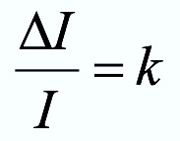
Weber’s law (1834)
Ratio of the just noticeable difference (JND ∆I) to initial stimulus I is a constant k across magnitudes of that stimulus
i.e., the JND is a constant proportion of the original stimulus value
Notes:
True for all stimuli, not just sound

Slide 20
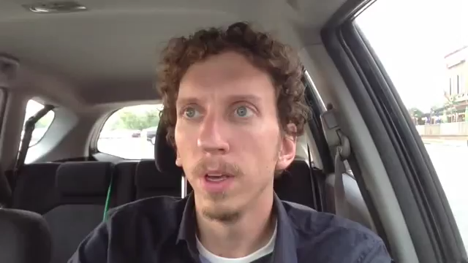
Weber’s law demo
Brad Way on YouTube
Notes:
True for all stimuli, not just sound

Slide 21
Context effects
Audio perception may be impacted by context
Background sounds
Position of sound relative to user
May be further impacted by social factors
People may not want to use speech input in public
May lower volume / mute devices

Slide 22
Connecting back to Norman/Nielsen
What is audio good for?
Feedback
Indicating system status
Representing mappings (sometimes)

Slide 23
Designing sound and representing data

Slide 24
Goals of sonification
Represent some data using sound
Starting with raw data, or an existing visual representation
As with visual processing, we want to represent many different types of information
Relationships between multiple objects
Changes over time
…

Slide 25

Why we should care
Often we talk about sonification as an accessibility feature
Making complex data accessible non-visually
Key question here about mappings and perceived characteristics of audio
Also relevant to designing other sounds
Is this a success or failure sound?

Slide 26
Representing things visually or sonically
Our ability to process information visually is very different than audio perception
This makes it difficult to translate from one to the other
In many cases, the best solution is to present information in multiple modes (“multimodally”)

Slide 27
Visual information (compared to audio)
Visual information is…
+ High bandwidth (1334 x 750 x 30 fps)
+ Easy to overlay and show multiple items
+ Easy to make information self-describing (with text)
+ Can rely on visual conventions (color, icons)
+ Easier to structure information
+ Can often browse or scan through information, and return back later
+ Can represent 2D or 3D
– Requires active attention
– Not always accessible

Slide 28
Audio mappings
So, does audio have mappings? Are they natural mappings?

Slide 29
Do audio mappings exist?
What is natural, what is cultural convention, what is learned?

Slide 30
Audio mappings
Some sounds are very recognizable (with training):
Can represent calmness or alertness:
Can represent affect:
Can represent changes in quantity:
Notes:
To be clear, sometimes it’s hard to disambiguate why we feel this way.

Slide 31
Sound mappings
Pitch, tempo → map to increasing and decreasing value
Stereo position → can map to actual position... maybe to value (but not necessarily)
Most everything else needs to be learned

Slide 32
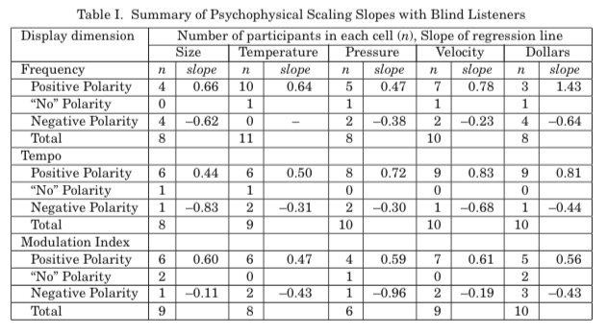
Mappings can be weird
Walker and Mauney, Universal Design of Auditory Graphs… TACCESS 2(3), 2010

Slide 33
Mappings can be weird
Walker and Mauney, Universal Design of Auditory Graphs… TACCESS 2(3), 2010

Slide 34
But what about 3D audio?
Can we just put everything in 3D?
Some specialized 3D audio systems use multiple audio sources (e.g. Ossic)
Simulated 3D audio uses stereo speakers and a model of the human head (head related transfer function or HRTF)
Works well when combined with visuals, or made responsive to head movements)
Not as effective on its own
Users may not always want to wear headphones

Slide 35
Audio aesthetics
Can audio make something sound “better”?
Sounds can indicate high quality components, materials, attention to detail…
Video: BMW designers on designing the sounds of their cars

Slide 36
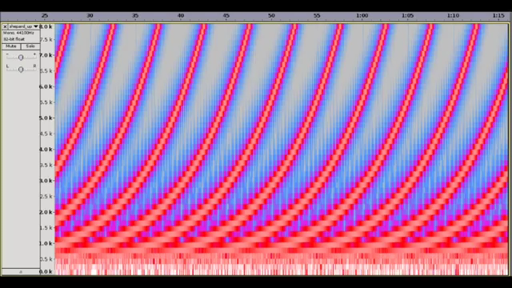
Audio illusions
Shepard Tones — audio appears to constantly rise (or fall) in pitch
Notes:
Human perception is interesting and if we understand it, we can do interesting things

Slide 37
Speech (briefly*) * more on this in Shaun’s Spring CSCI 7000 course

Slide 38
Speech input
Today it is easy to use speaker-independent, untrained speech input
This is a big deal and relatively recent
Array microphones (e.g. Amazon Echo) enable speech input at a distance
Designing effective speech interfaces is an open challenge

Slide 39
Challenges to speech input
When is system listening?
How do users know what to say?
Telling users they can use “natural language” is a big risk, if the system gets it wrong
Natural language commands can take many forms
Both phrasing and structure of command
“Send a message”, “Send a message to Kevin”, “Message Kevin”, ”Tell Kevin that I’m going to be late”
Handling errors can be confusing — users may get louder, enunciate more (which might not help)
Best solution may vary based on context (mobile vs. home vs. shared office vs. private office)

Slide 40
Speech output
Becoming more common in mainstream technology
More natural voices
This is a moving target as users become more accustomed to interacting with voice
Speech rates vary widely
Human speech ~150 words per minute; expert screen reader users up to 500 wpm
Notes:
Screen reader users often prefer less natural voices; artificial voices may be more intelligible at high speed

Slide 41

Screen readers are fast
Rhea Guntalilib, How Blind People Use Computers
Notes:
Screen reader users often prefer less natural voices; artificial voices may be more intelligible at high speed

Slide 42
Interesting applications of audio

Slide 43
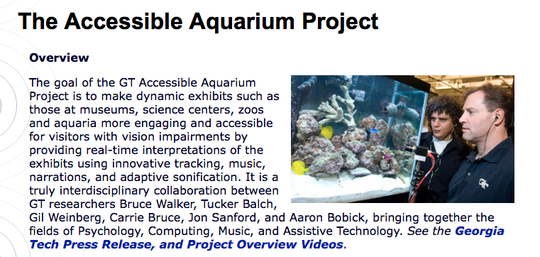
http://sonify.psych.gatech.edu/research/aquarium/
http://sonify.psych.gatech.edu/research/aquarium/

Slide 44
Earcons and spearcons
Examples from ICAD
Earcons
Open
Paint
Spearcons
Elephant
Braxton Philbrick
Tactons → haptic signals

Slide 45
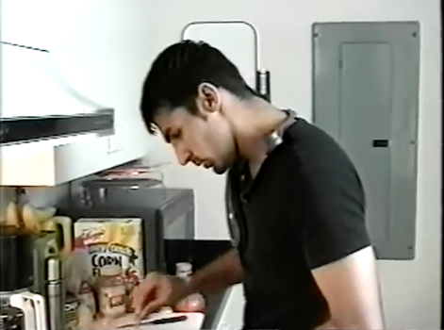
Nomadic Radio

Slide 46
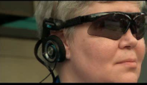
The VOICE
Use computer vision to sonify the environment
Map various feature detectors to sound
Requires extensive training (and may not actually be useful…)

Slide 47
Hearables and audio AR
Wireless headphones that can be worn all day
“Pass through” augmented audio
Here - selective noise cancellation
Pixel Buds - real-time translation
Issues around battery life, comfort, social acceptability?
Notes:
Image from The Verge

Slide 48
Voice input

Slide 49
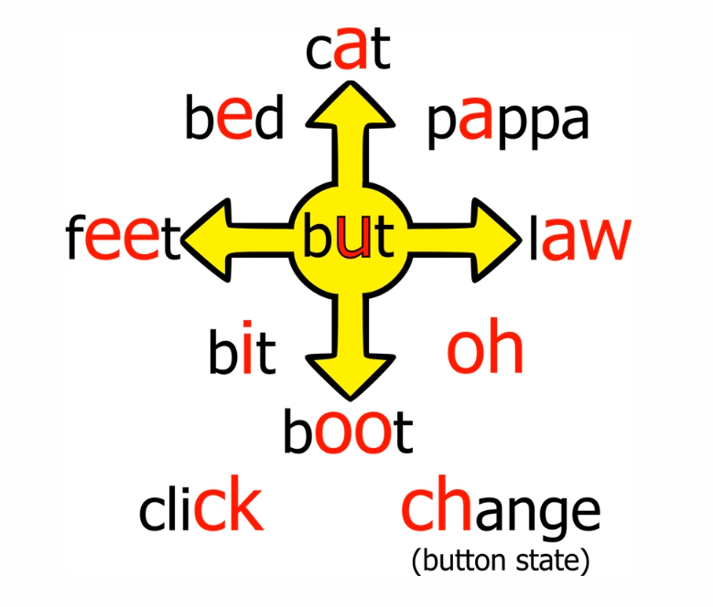
Vocal Joystick and VoiceDraw
How to use speech input if you cannot speak (or cannot speak clearly)?
Use nonspeech vocal sounds as input

Slide 50
VoiceDraw video

Slide 51
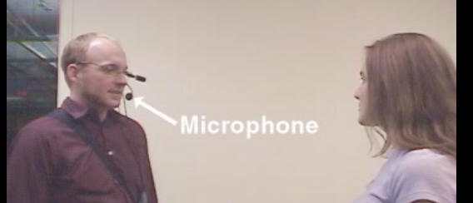
Dual-Purpose Speech

Slide 52
Sonifications
SAS graphics accelerator
Tangible interactive sonification
sound/tracks
Altering walking sounds
Real time finance sonification
Listen to Wikipedia
Eclipse Soundscapes
Sonification Sandbox

Slide 53
How to design a sonification
What is it that you want to communicate about the data? (top 2-4 variables)
What are the variables? Do we know their range, distribution?
Interactive, single sound, or sequence of sounds?
Order data in a logical way (if possible)
Map data (and inputs, if interactive) to outputs

Slide 54
Inputs and outputs
Inputs
Data itself
Touch or keyboard input
Outputs
Timbre / instrument
Pitch
Volume
Stereo position
Other audio effects (vibrato, high/low pass filter, etc)

Slide 55
Assignment
We are going to design sonification mappings
Time in class to experiment with ideas, tools

